Slide 1

Introduction to Machine learning
Sklearn and Tensorflow - with Raspberry PI edge

Slide 2

source: https://xkcd.com/1838/
Notes:
source: https://xkcd.com/1838/

Slide 4
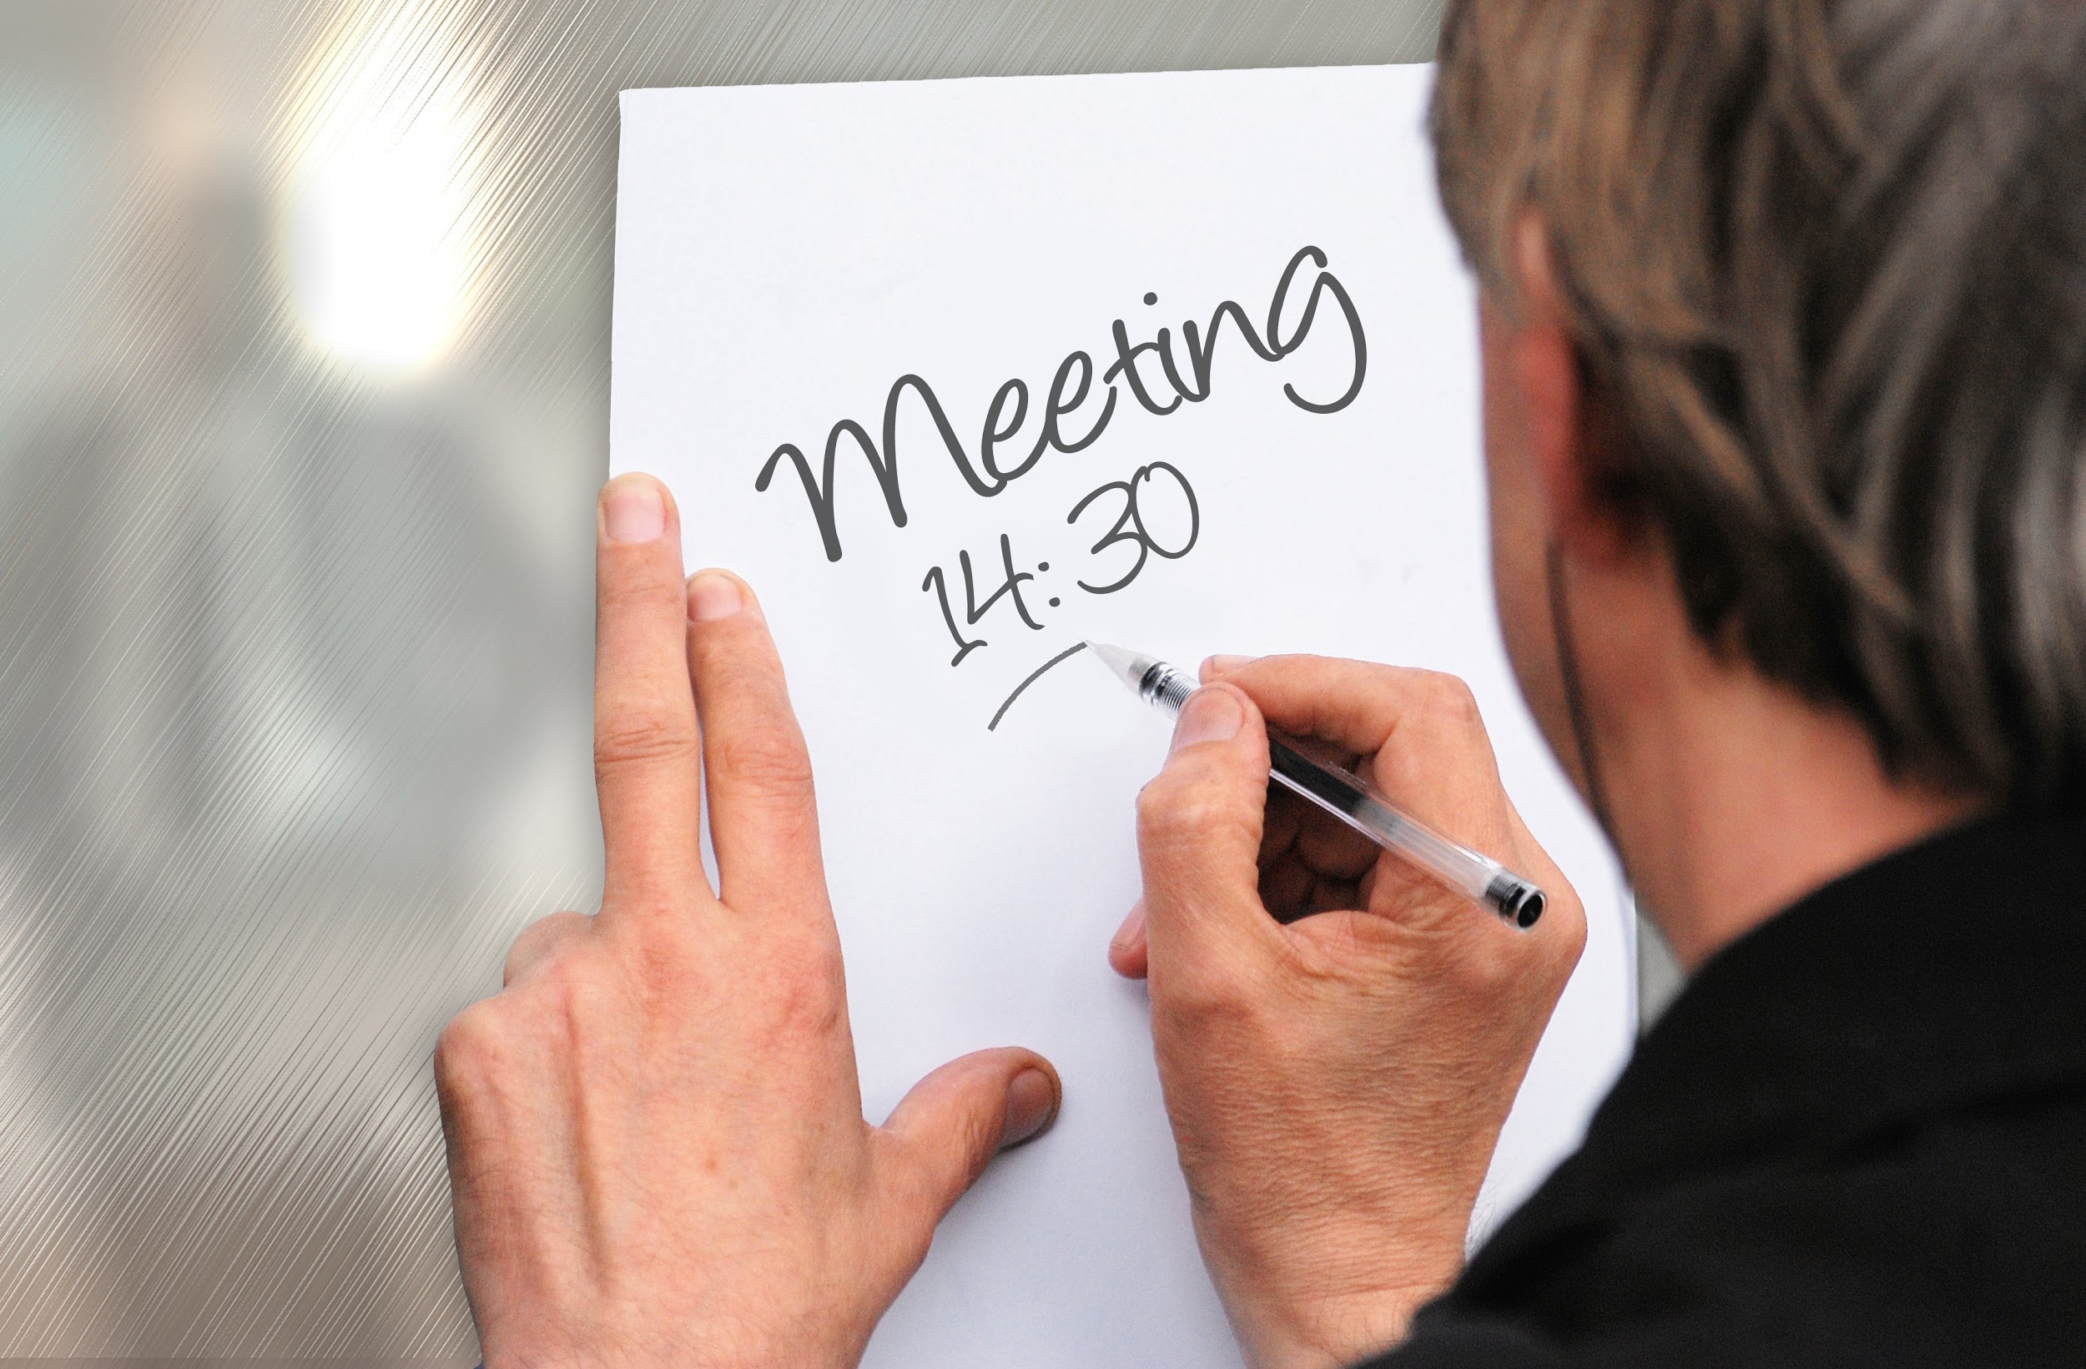
Agenda
Machine learning basics
Scikit-learn and Tensorflow
Creating a usage with Rpi
Introduction to Machine learning
Raspberry PI – Machine learning
Hands on with Scikit learn
Tensorflow example
Image recognition
Real time use case
Notes:
TimeAgendaThings to be covered in this session
10:00 - 10:15Walkthrough through the Day schedule
10:15 - 11:15Introduction to Machine Learning and Raspberry PI --- Introduction and scope of Machine Learning ( 30 mins) Setting up Raspberry pi and required environment for the days workshop ( 30 Mins )
11:30 - 12:30 Scikit-learn and Tensorflow introduction -----
Introduction of Scikit-learn Library explaining about the inbuilt classifiers Simple Hands on with Scikit-learn library Introduction to Tensorflow Simple hands-on with Tensorflow example
12:30 - 1:30Lunch Break
1:30 - 2:45Build Image classifier example Image Recognition using Tensorflow Library
2:45 - 3:00Short break
3:00 - 4:30Putting things together -- Integrate PI and use Image recognition in real-time use cases
4:30 - 5:00NetworkingOpen discussion - if any spillover

Slide 5
Machine Learning Basics - Session 1
Introduction to Machine learning
Raspberry PI – Machine learning
What is machine learning
What are the two main categories of machine learning?
What are some examples of machine learning?
How does machine learning "work"?
Introduction to Raspberry pi
Setting up the environment for the day
Notes:
TimeAgendaThings to be covered in this session
10:00 - 10:15Walkthrough through the Day schedule
10:15 - 11:15Introduction to Machine Learning and Raspberry PI --- Introduction and scope of Machine Learning ( 30 mins) Setting up Raspberry pi and required environment for the days workshop ( 30 Mins )
11:30 - 12:30 Scikit-learn and Tensorflow introduction -----
Introduction of Scikit-learn Library explaining about the inbuilt classifiers Simple Hands on with Scikit-learn library Introduction to Tensorflow Simple hands-on with Tensorflow example
12:30 - 1:30Lunch Break
1:30 - 2:45Build Image classifier exampleImage Recognition using Tensorflow Library
2:45 - 3:00Short break
3:00 - 4:30Putting things together -- Integrate PI and use Image recognition in real-time use cases
4:30 - 5:00NetworkingOpen discussion - if any spillover

Slide 6
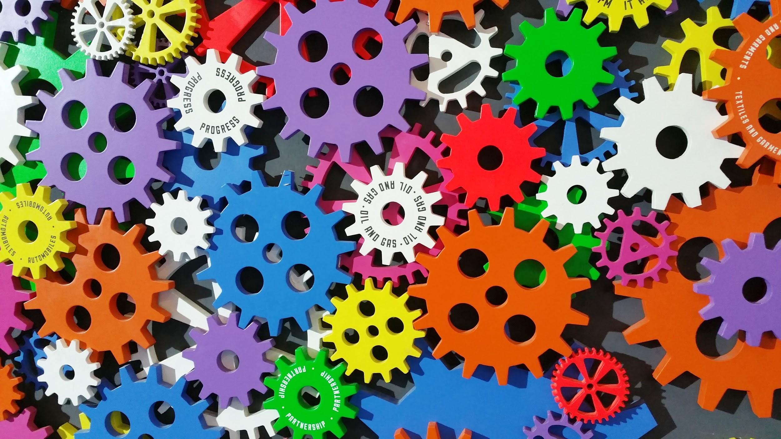
What is machine learning?

Slide 7
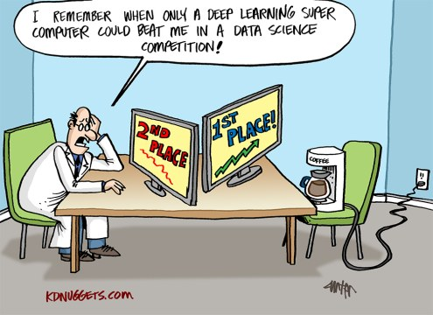

Slide 8
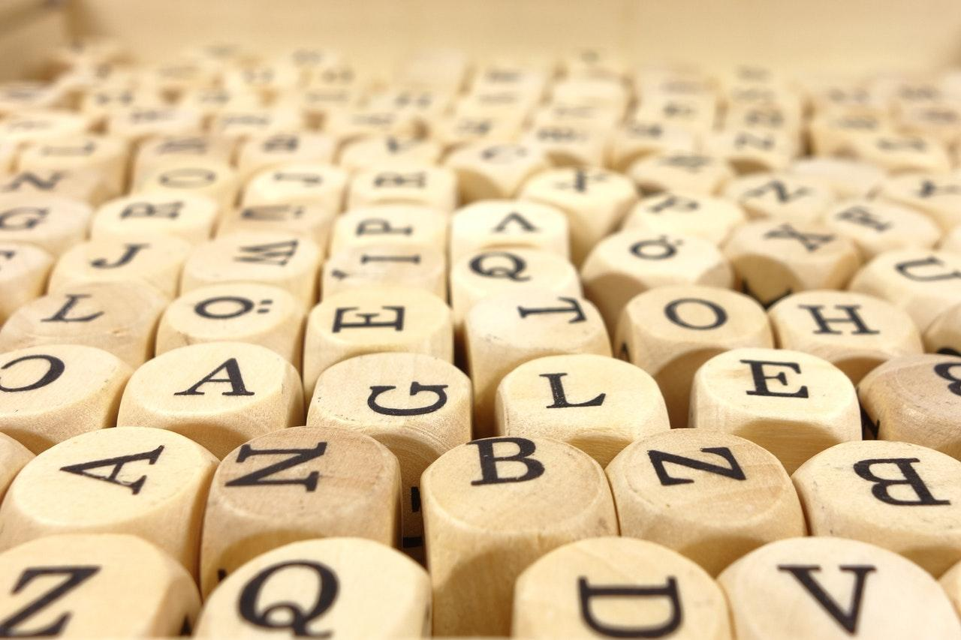
One such definition
"Machine learning is the semi-automated extraction of knowledge from data"
Notes:
Knowledge from data: Starts with a question that might be answerable using data
Automated extraction: A computer provides the insight
Semi-automated: Requires many smart decisions by a human

Slide 9
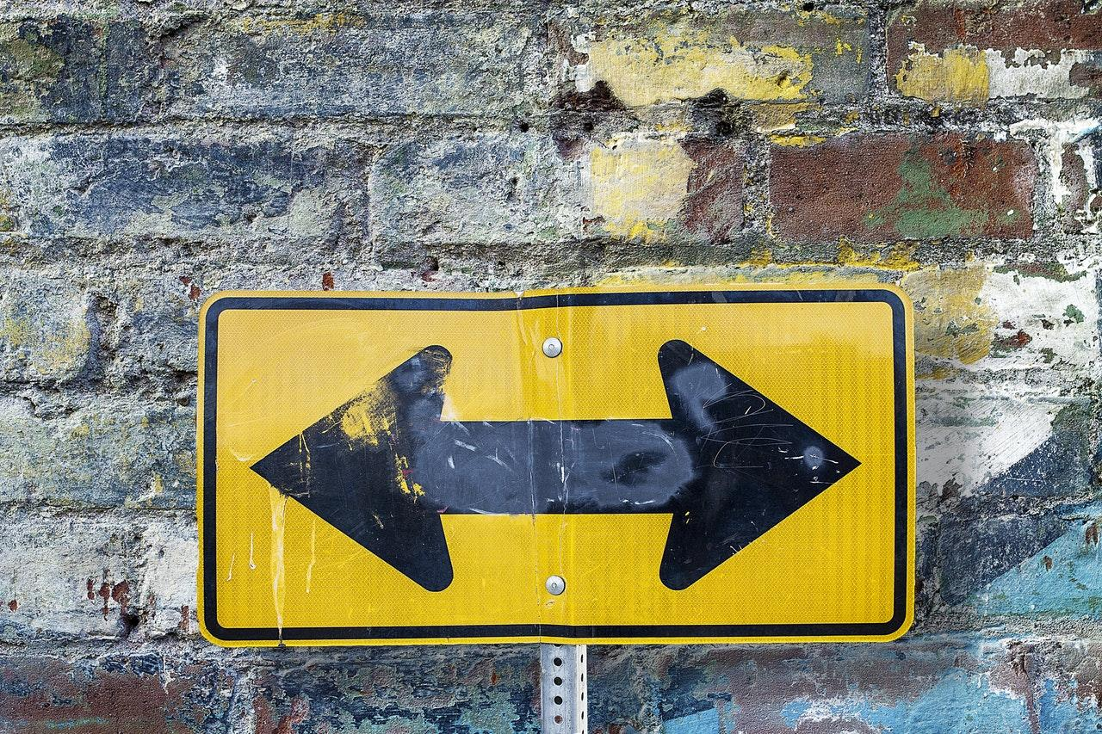
Categories
Supervised Learning
Predictions using data
Example: Is a given email "spam" or "ham"?
UnSupervised
Extracting structure from data
Segment grocery store shoppers

Slide 10

Supervised Learning
Notes:
Supervised learning is concerned with learning a model from labeled data

Slide 11
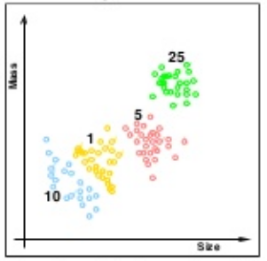
Classification
Classify the observations in a set of finite labels
learn from already labeled data how to predict the class of unlabeled data
Example- Apple / Orange
Iris dataset
Yes/No

Slide 12
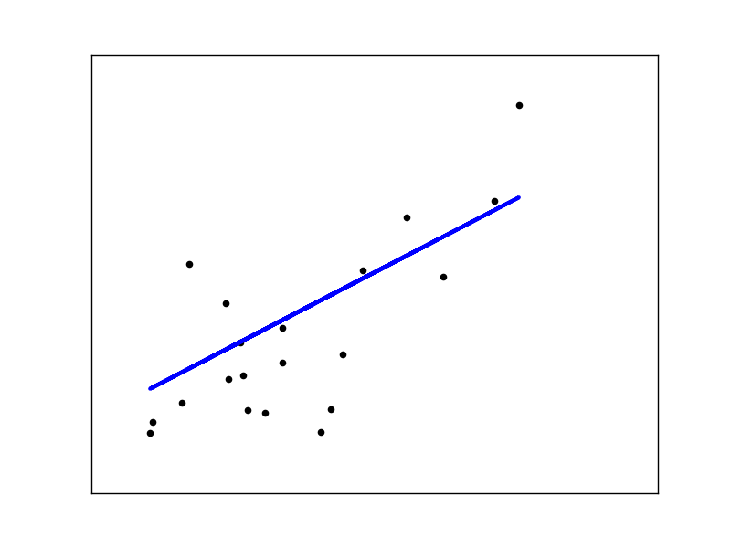
Regression
predict a continuous target variable
Example-
Linear regression - Diabetes set
Boston House Price dataset
How much/ how many

Slide 13
Unsupervised Learning
Notes:
UnSupervised learning is concerned with learning a model from labeled data

Slide 14
Unsupervised learning
if you are training your machine learning task only with a set of inputs
which will be able to find the structure or relationships between different inputs
Most important unsupervised learning is clustering, which will create different cluster of inputs and will be able to put any new input in appropriate cluster
Example:
identifying close-knit groups of friends in social network data

Slide 15
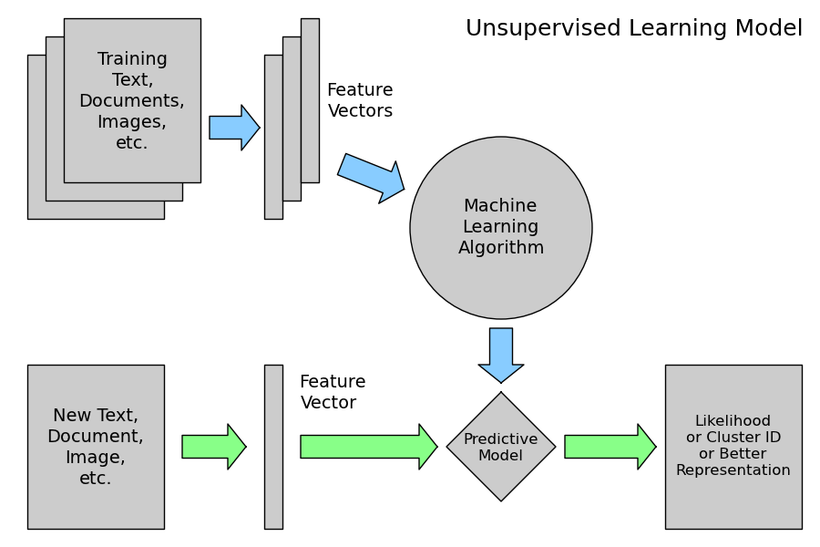
Unsupervised learning Model

Slide 16
Basics
Linear Regression
Weight / Bias
Cost Function
Gradient Descent to optimize a cost function
Logistic Regression
Neuron Activation

Slide 17
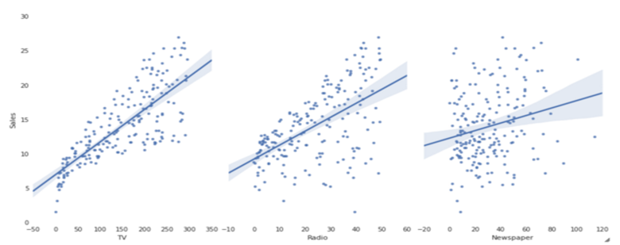
Linear Regression
Objective: Fit line/curve to minimize a cost function
Line has "Weight / Slope" and "Bias / y-intercept)

Slide 18
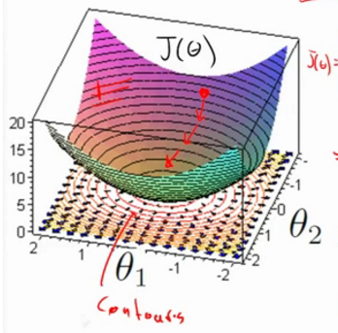
Cost Function, Gradient Descent
Starts with some Weights & Biases
Define a Cost Function
Optimize the Cost function by doing some sort of Gradient Descent
Lots of Help from TensorFlow

Slide 19
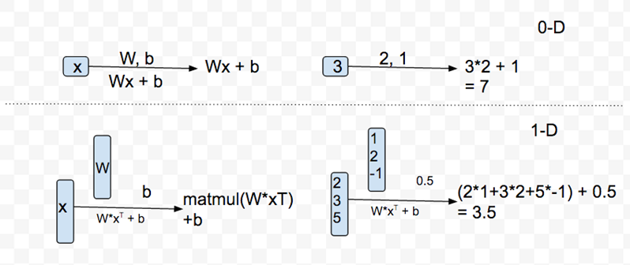
Weight, Bias in 0,1 Dimensions

Slide 20
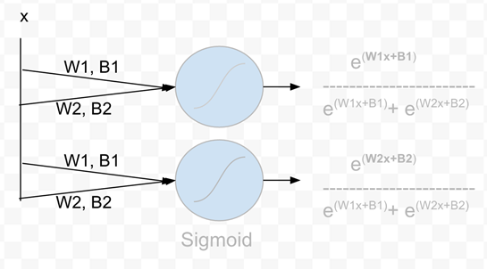
Neuron and Activation Function
Only one of the Neurons will fire at a time (value shoots greater than 0.5)
Which neuron depends on "x", Weights, Biases
Rest of neurons will not fire. (value much less than 0.5)
Outcomes are between 0 and 1 → Probabilities (all outputs add to one)
Good for classification

Slide 21
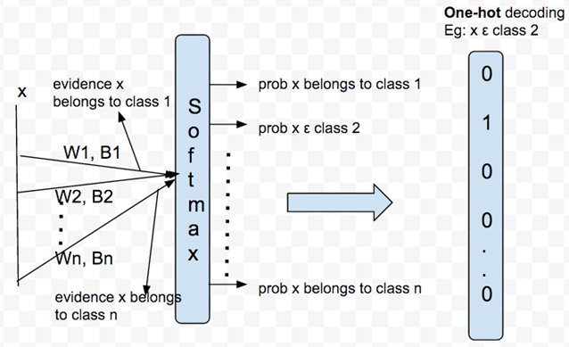
Softmax

Slide 22
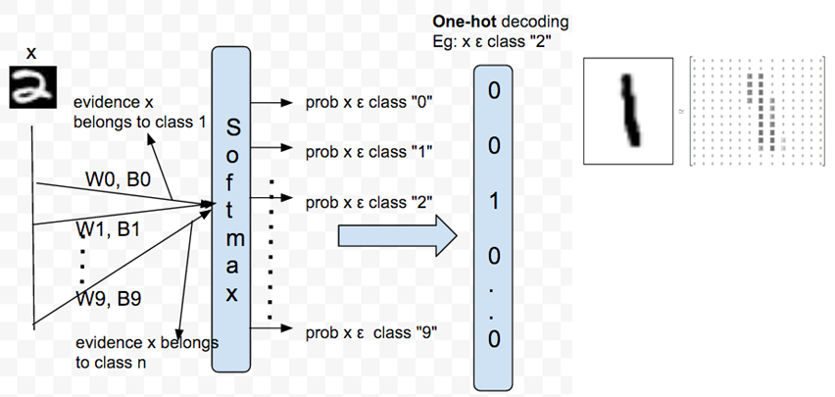
Simple Neural Network for MNIST

Slide 23
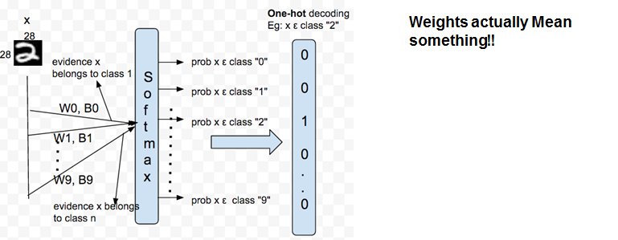
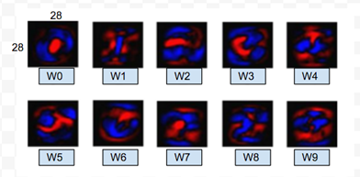
Simple Neural Network for MNIST

Slide 24
CNN - Convolutional Neural Network
CNN inspired by the Visual Cortex.
CNNs are deep nets that are used for image, object, and even speech recognition.
Pioneered by Yann Lecun (NYU)
Deep supervised neural networks are generally too difficult to train.
CNNs have multiple types of layers, the first of which is the convolutional layer.
Error detection drops

Slide 25
Convolution NN -
Convolution layer
RELU - Rectified linear unit
Pooling

Slide 26
RNN - Recurrent Neural Network
Structure → the o/p of CNN is fed back with changing t
Usage → Sequence of Input / Sequence of output
Example →
Image captioning
Document classification
Classify video

Slide 27
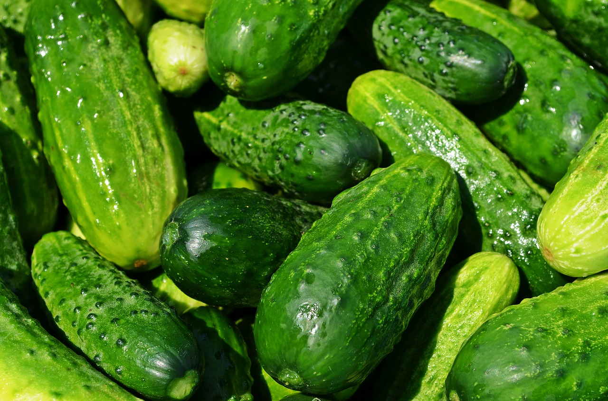
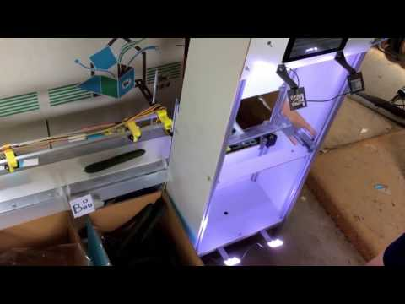
Tensor Flow Cucumber sorter
https://youtu.be/4HCE1P-m1l8

Slide 28


